Slide 1
Making Canvas Courses Accessible
DRAFT
(Adapted from materials by Helen Graves, updated and tailored for Ohlone College Spring 2019)

Slide 2
Begin with the End in Mind (Covey, 1989)
Accessibility is not optional.
Don’t wait for a request. Make sure everything you create is accessible.
There are departments here who can help.

Slide 3
Pop Quiz (Not Really)
Let’s talk about what you may already know
Headings
Lists
Tables
Links
Alt Text (Images)
Color
Captioning
Notes:
No need to waste time discussing things you already know about.

Slide 4
Universal Design
Multiple means of representation Give students the same information through different formats (visual, auditory, or textual) to ensure that key information will be equally perceptible to all.
Multiple means of action and expression Give students plenty of options for expressing what they know, and provide models, feedback, and supports for their different levels of proficiency.
Multiple means of engagement What excites one student may bore another! Give students choices (working independently vs. working collaboratively, the sequence or timing of tasks, the level of challenge, etc.) to spark their interests and autonomy.
Notes:
Examples? (Slides, reading, lecture, video)
Small group, class discussion, presentation, written homework, testing

Slide 5
Rich Content Editor
Only content created within the rich content editor will be checked with the accessibility checker.
Rich Content Editor Accessibility Guidance

Slide 6
Heading Basics
The Accessibility checker will not always flag heading errors
Nest headings by their rank/level, in reverse order.
In Canvas, the page title has the rank 1, and page headings descend from main rank 2 to sub-rank 4
Skipping heading ranks can be confusing and should be avoided where possible

Slide 7
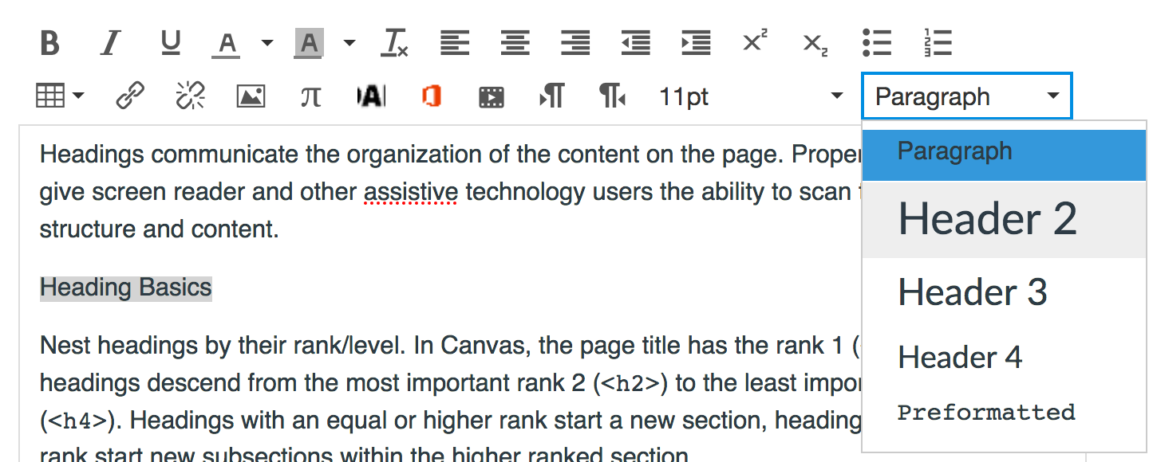
Formatting Headings with Canvas' Rich Content Editor (RCE)
Highlight the text of your heading.
Click the text dropdown menu.
Select the heading level.
Once a heading has been styled using the RCE, you can make format changes (bold, italics, font size or color), if desired.
Notes:
Show on syllabus

Slide 8
Lists
Lists provide an easily understood, structured order to content. Lists can be a potential replacement for simple tables (which tend to be more difficult to navigate using a screen reader). As long as we're talking about lists, let's clarify that there are two kinds:
Ordered (numbered): these are used to indicate a sequence or progression
Unordered (bulleted): these are used for content items with no order of importance

Slide 9
Lists Continued
Lists should be created using the Rich Content Editor (RCE) rather than manually (using the spacebar) so the list is properly tagged in the html code and a screen reader device can interpret it as an actual list.

Slide 10
Formatting Lists with Canvas' Rich Content Editor (RCE)
Type the list items as separate lines of text.
Highlight the list content.
Click the bulleted (unordered) or numbered (ordered) list tool in the RCE.
Notes:
Show in first part of syllabus where instructor and class info is

Slide 11
Tables 1
Tables convey information spatially by organizing data in a grid but students with sight impairments can't benefit from this visual illustration of the relationship between cells. To make tables usable by everyone, they need HTML markup that indicates header cells (describing the category of data in that row/column) and data cells.
In the majority of data tables, column headers are needed. Some tables do not have data that would require any header cells, and some tables need both column and row header cells indicated, as shown below.

Slide 12
Table Example
 | Col Header | Col Header | Col Header | Col Header | Col Header
 | Breed | Type of Breed | Coat | Lap Cat | Adult Weight
Row Header | Bengal | Hybrid | Short | No | 15
Row Header | Scottish Fold | Natural/Mutation | Short | No | 9
Row Header | Siberian | Natural | Long | Yes | 14
Row Header | Tonkinese | Crossbreed | Short | Yes | 10

Slide 13
How to set table headers
Click the Edit button and reveal the Rich Content Editor.
Click the Accessibility Checker icon (the little man) in the RCE toolbar.
You'll be prompted to add a descriptive caption to your table; then click "Apply".
You'll then be prompted to set table headers.
Choose Header row, Header column or Header row and column from the dropdown menu and click "Apply".
Notes:
Show using SLO table

Slide 14
Setting Table Headers

Slide 15
Setting the Table Row Properties Manually
You can also set the header cells of a table from within the Table tool:
Click the Edit button and reveal the Rich Content Editor.
Click on a cell in the table (or highlight the entire row/column).
Click on the table icon in the Rich Content Editor toolbar to access a drop down menu.
Choose Row > Row properties.

Slide 16
Row Properties Drop Down Menu

Slide 17
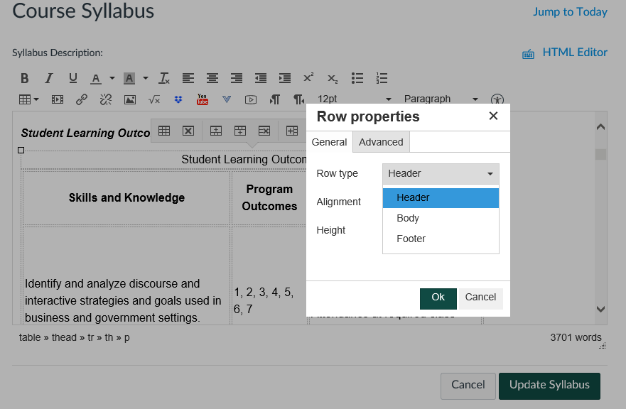
Row Properties Continued
Set the Row type to Header Row.
If using both Column and Row headers, set the Scope to Column or Row depending on the type of cell.
Click OK and then save the page.

Slide 18
Color Contrast
Because sufficient contrast between foreground (text) and background is important, it's recommended that you NOT "liven" up your page with colored or highlighted text; instead use images for visual interest.
There may be times when colored or highlighted text is appropriate. Changing colors for text and background (highlighting) in Canvas is done using the Text Color and Background Color icons in the Rich Content Editor.

Slide 19
The graphic below shows you which default colors in the Canvas RCE have appropriate contrast.

Slide 20
Note on Colors
If you stick to the top row of colors on a white background (bottom row on black), you're always within the guidelines.
Although text colors with appropriate contrast against a black background are shown, it's HIGHLY discouraged to use light text against a black/dark background. It tires the eye quickly and can produce a shimmering effect that's hard to read.

Slide 21
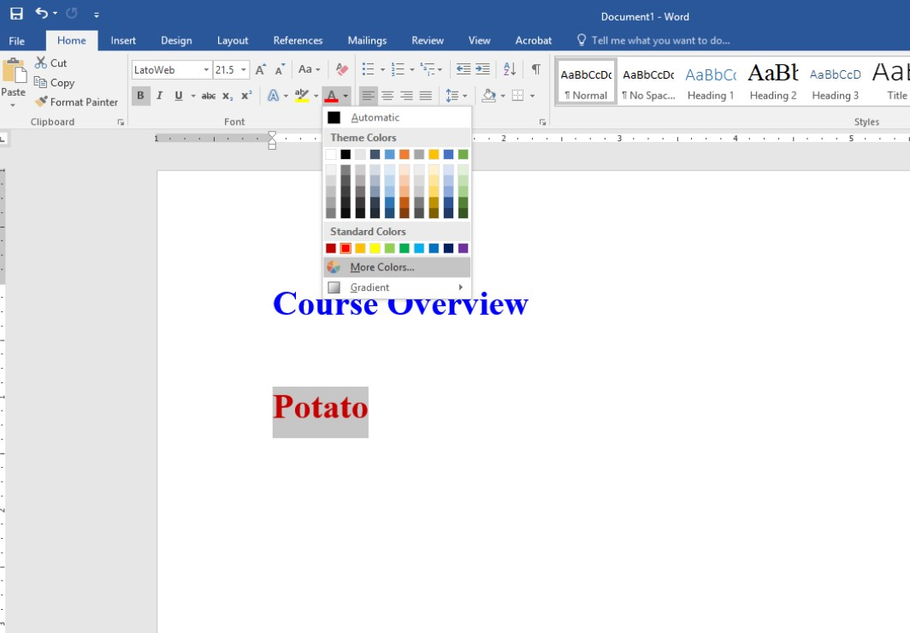
Using Contrastchecker.com
A not so super efficient way to check color in Canvas (but great for Word)
Copy/Paste into a Word Doc

Slide 22
Checking Contrast

Slide 23
Contrastchecker.com

Slide 24
Color and Meaning
Learners who are blind, low-vision, or colorblind will not be able to differentiate between the content you are trying to emphasize or highlight if you use only color to convey meaning. Problematic examples include:
Highlighting required fields in forms
Directing students to "Pay special attention to the learning concepts in blue"
A pie chart sectioned by color
It's OK to use color to convey meaning as long as that meaning is indicated in some other way as well (italics, bold, a symbol, etc.).

Slide 25
Images (alt text)
Alternative text--a written description of non-text content in web pages--has two important functions for accessibility:
It's read by screen reader devices in place of images, allowing the content and function of the image to be understandable to those with visual or certain cognitive disabilities.
It's displayed in place of the image in browsers if the image file is not loaded or when the user has chosen not to view images.

Slide 26
How much Alt Text?
It should be succinct--not more than 20 words is the recommendation--while communicating the "experience" of the image.
A lot depends on the context of the page content where the image is being presented. If much about the image is already described in the surrounding text, the alt text can be quite brief.

Slide 27
Tips for Writing Alt Text
Ask yourself: "Why am I using this image? What information is it meant to convey?” (What's the pedagogical context?)
Keep it concise yet informative (convey the full experience of the image).
Don't include "image of" or "picture of" in the alt text; the screen reader will indicate it's an image. An exception would be if it's germane to the learner's experience to know, for example, that the image is a photo collage or an engraved illustration.
Remove the file type (.jpg, .png, etc.) from the alt text

Slide 28
Alt Text Example
Not Good: Alt Text: online learning
Good: Alt Text: computer mouse sitting on top of open book to represent the idea of online learning

Slide 29
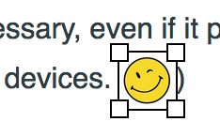
Formatting Alt Text with Canvas' Rich Content Editor (RCE)
Once the page editor is open, click on the image (it will display a bold outline with squares in each corner to indicate it's selected).

Slide 30
Click the Embed Image icon in the RCE menu.

Slide 31
In the pop-up dialogue box, type an appropriate description in the alt text field OR select the Decorative Image box.

Slide 32
What Is "Appropriate Captioning?”
Many instructors aren't aware that auto-generated captioning (as is found on most YouTube videos) is not sufficient for accessibility.
Proper captioning needs punctuation and appropriate word-matching. (If you doubt me, try watching a poorly captioned video with the sound turned off!)

Slide 33
If you created the video:
Use a video-editing tool (e.g., Screencast-o-matic, YouTube) to adjust the captions as needed.
You can upload a transcript and then adjust the timing, or auto-caption and then fix the errors.
Contact SAS for help getting your media captioned. We have a few vehicles for captioning.
This solution requires adequate lead time and is not appropriate for on-the-fly captioning.
Notes:
Have YT open in another window

Slide 34
If you didn't create the video:
Amara is a website.: Offers both open software for captioning 3rd-party educational videos and an archive of videos already captioned by others. (A free account is required.)
Add/edit captions using the YouTube "Community Captions" tool (Links to an external site.)Links to an external site.. (Many YouTube users aren't aware of the feature so you may need to request that the owner of the YouTube channel turn it on first.)
Do a search on YouTube or Google for whatever search terms are appropriate and then filter for “closed captioned.” (You’ll still have to double-check to make sure the captioning is good enough, but it will cut down on the number of obviously bad choices in your search results. =-))

Slide 35
A Note on DE Live Lectures
If you are conducting live lectures through Canvas/Zoom for your course you must secure captioning services in advance if you have a Deaf student.
You can get live captioning on your own through CCC Confer or through SAS using the DECT grant.
Providing a transcript after the fact is not a sufficient accommodation.
Notes:
You’ll know if you have a Deaf student because you will receive an accommodations letter at the start of the semester.

Slide 36
Checklist
Content exceeding ½-page is chunked using meaningful section headings
Heading styles are nested in sequential descending order
Images have appropriate alt text
Images not related to page content are designated as decorative
Link text is meaningful and in context
Underlining is not used for emphasis
Color contrast is sufficient
Color alone is not used to convey meaning
Lists are formatted using the default list tool
Table have properly tagged column/row headers
Videos have proper captioning (not auto-generated)
Audio has appropriate transcripts
Video/audio not set to auto-play

Slide 37
Screen Readers
Desktop
Windows: JAWS and NVDA (latest version for Firefox)
Macintosh: VoiceOver (latest version for Safari)
There is no screen reader support for Canvas in Chrome, IE11, or Edge browsers
Mobile Apps
Android: Talkback (latest OS version)
iOS: VoiceOver (latest OS version)

Slide 38
Multiple Attempts and Extra Time
Extra Attempts on a Published Quiz
Adding Time to a Published Quiz

Slide 39
Other Resources
UDOIT Homepage
Making Google Docs Accessible

